Slide 1
MIMS:
Medical Information
Management System
Denney Burkholder, Alyssa Kelley, Leo Reyes, Alexandra Garcia, Albert Wallace

Slide 2
MIMS:
Medical Information
Management System
Denney Burkholder, Alyssa Kelley, Leo Reyes, Alexandra Garcia, Albert Wallace

Slide 3
part
2
Design

Slide 4
part
2
Design

Slide 5
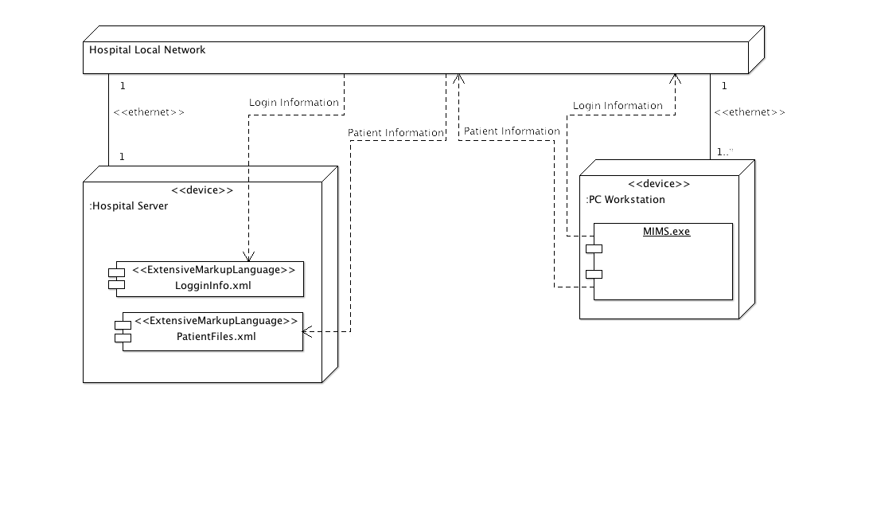
Deployment Diagram
POWERPOINT BY LEO REYES

Slide 6
Deployment Diagram
POWERPOINT BY LEO REYES

Slide 7
collaboration Diagram
Diagram 1
POWERPOINT BY LEO REYES

Slide 8
collaboration Diagram
Diagram 1
POWERPOINT BY LEO REYES

Slide 9
collaboration Diagram
Diagram 2
POWERPOINT BY LEO REYES

Slide 10
collaboration Diagram
Diagram 2
POWERPOINT BY LEO REYES

Slide 11
collaboration Diagram
Diagram 3
POWERPOINT BY LEO REYES

Slide 12
collaboration Diagram
Diagram 3
POWERPOINT BY LEO REYES

Slide 13
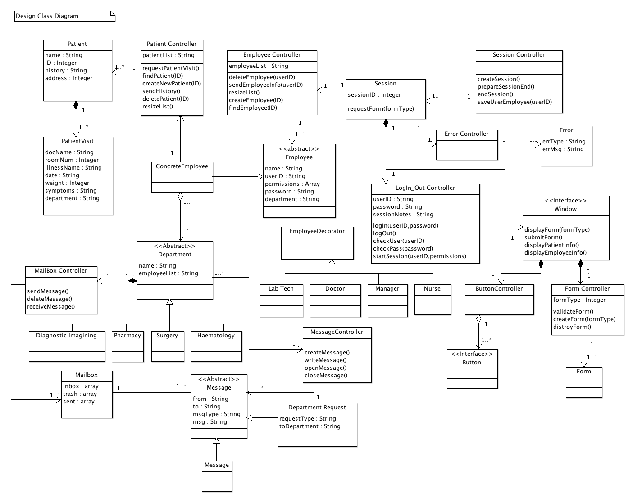
Design Class Diagram
Diagam 3

Slide 14
Design Class Diagram
Diagam 3

Slide 15
Design Class Diagram
Diagam 3
Bullets explaining which we chose design pattern we chose and why we picked this one / why it works

Slide 16
Design Class Diagram
Diagam 3
Bullets explaining which we chose design pattern we chose and why we picked this one / why it works

Slide 17
Class design
Design1 & Requirements
POWERPOINT BY LEO REYES

Slide 18
Class design
Design1 & Requirements
POWERPOINT BY LEO REYES

Slide 19
Design Evolution
Write the design
evolution in here
POWERPOINT BY LEO REYES

Slide 20
Design Evolution
Write the design
evolution in here
POWERPOINT BY LEO REYES

Slide 21
MIMS:
Medical Information
Management System
Denney Burkholder, Alyssa Kelley, Leo Reyes, Alexandra Garcia, Albert Wallace

Slide 22
MIMS:
Medical Information
Management System
Denney Burkholder, Alyssa Kelley, Leo Reyes, Alexandra Garcia, Albert Wallace

